Slide 1


SAVEETHA SCHOOL OF ENGINEERING
AI-Based Smart Road Pothole Detection
Using Computer Vision
Presented by:
KARTHIGA G [192421383]
GUIDED BY:
Dr. S Christy Melwyn

Slide 2
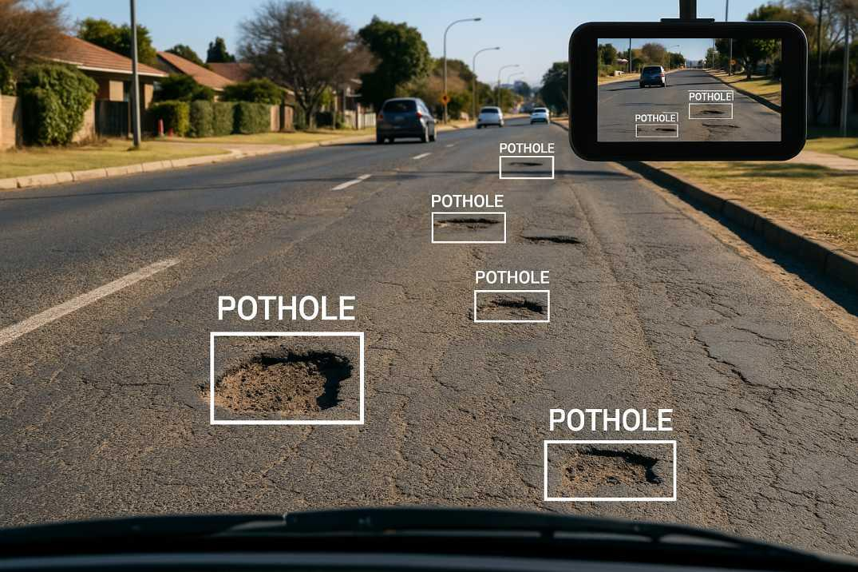
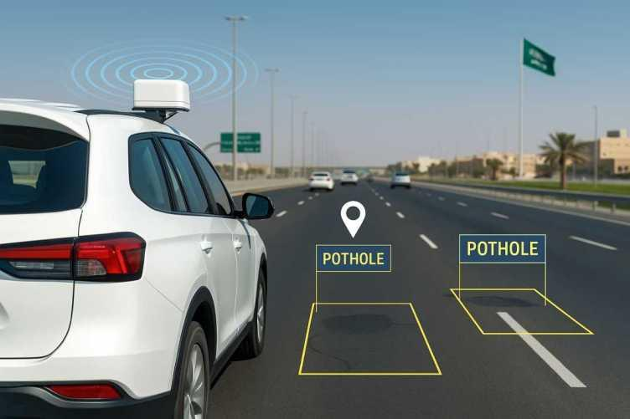
INTRODUCTION
The project uses Artificial Intelligence (AI) and Computer Vision to automatically detect road potholes.
Road images are captured using cameras mounted on vehicles or surveillance systems.
The captured images are preprocessed to improve image quality and remove noise.
Deep learning models such as CNN or YOLO analyze the images to identify potholes accurately.
The detected potholes are highlighted with their location for quick maintenance.
The system enables real-time road monitoring, reduces manual inspection, and improves road safety.
AI-based detection helps authorities perform timely repairs, reducing accidents and vehicle damage.

Slide 3
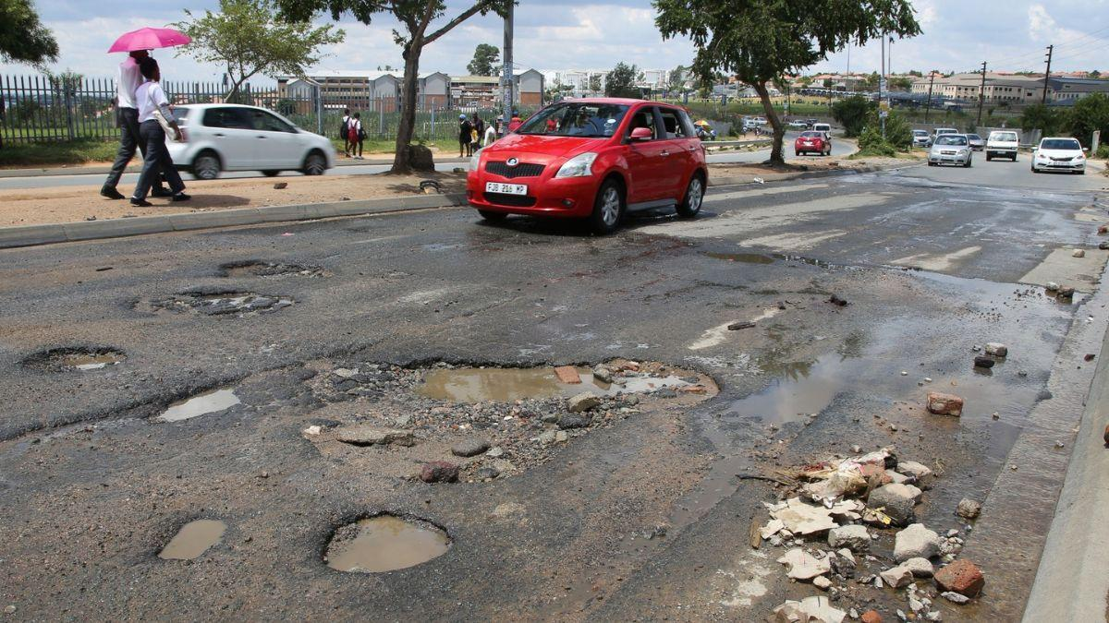
NEED FOR PROSPOSED SYSTEM
Problem Statement:
Many roads develop potholes that remain undetected for long periods. Delayed identification leads to accidents, vehicle damage, traffic congestion, and increased maintenance costs.
Current inspection methods:
Depend on manual surveys
Require more manpower
Consume more time
Cannot continuously monitor roads
Often miss small road damages
Objectives:
To develop an AI-based smart road pothole detection system using Computer Vision that accurately identifies potholes from road images or videos, enabling faster road maintenance and improving public safety.

Slide 4
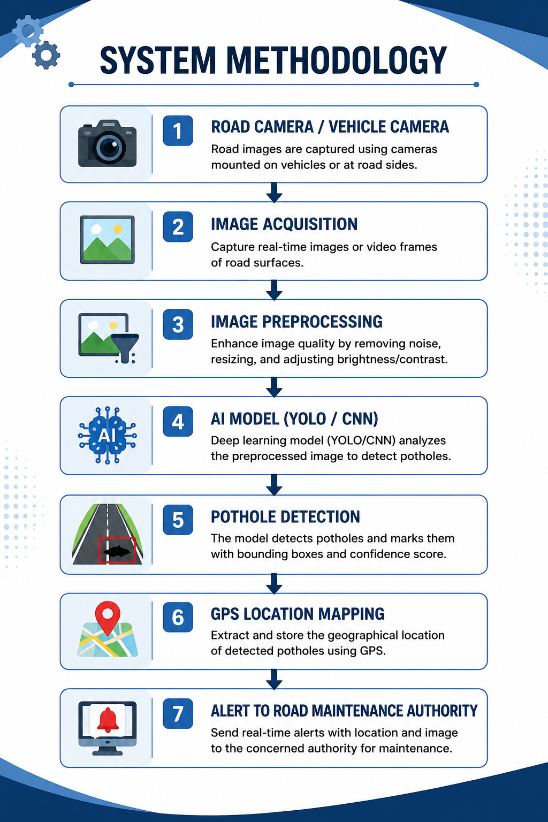

Slide 5
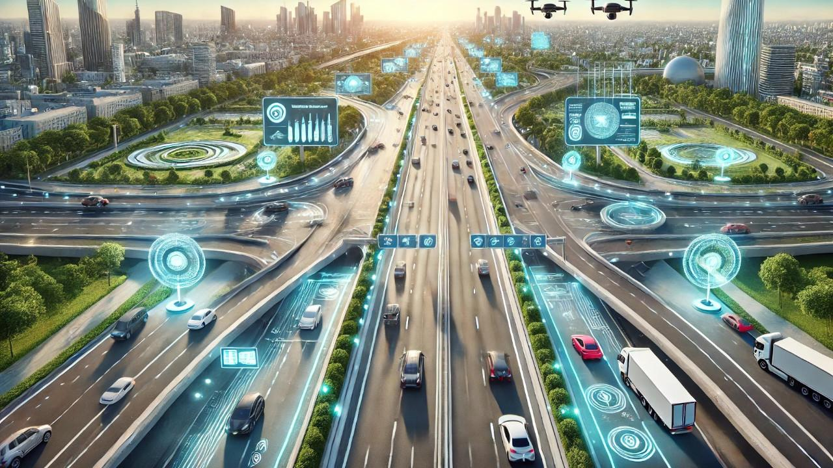
Results & Advantages
Expected Results
The developed system is capable of automatically detecting potholes with high accuracy from road images.
Results
Fast pothole detection
Accurate localization
Real-time monitoring
Reduced inspection time
Automatic reporting
Advantages
Improves road safety
Reduces accidents
Saves maintenance cost
Minimizes human intervention

Slide 6
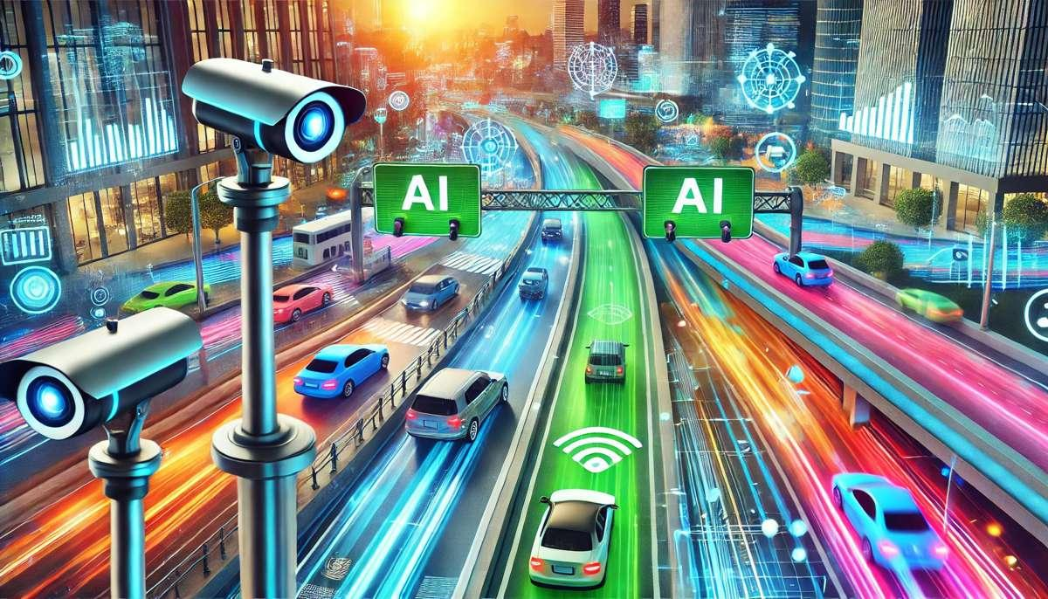
FUTURE SCOPE
The proposed system can be further enhanced by integrating advanced technologies such as:
Drone-based road inspection
IoT-enabled smart road monitoring
Cloud database for road maintenance
Mobile application for citizen reporting
Predictive maintenance using AI
Integration with autonomous vehicles
Smart city traffic management

Slide 7
CONCLUSION
The AI-Based Smart Road Pothole Detection System provides an intelligent, automated, and efficient approach to identifying road damage. By combining Artificial Intelligence with Computer Vision, the system reduces manual inspection efforts, increases detection accuracy, enhances road safety, and enables faster maintenance. This technology has significant potential for supporting future smart transportation and smart city infrastructure.

Slide 8


